Slide 1
Supervised Learning
Aram Saeed

Slide 2
Supervised learning
Supervised learning is a type of machine learning paradigm where an algorithm learns from labelled training data to make predictions or decisions without human intervention. It is one of the most common and widely used approaches in machine learning. In supervised learning, the algorithm is provided with a dataset consisting of input-output pairs, where the input (also called features) is a set of variables or attributes, and the output (also called labels or target) is the desired prediction or classification.

Slide 3
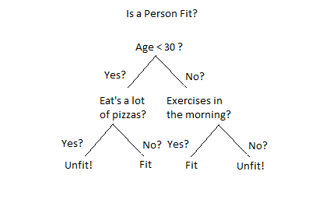

Slide 4
Supervised learning can be categorised
Classification: In classification, the goal is to predict a discrete label or category for each input. For example, spam email detection, image classification (e.g., recognizing whether an image contains a cat or a dog), and sentiment analysis (predicting whether a text is positive or negative sentiment) are common classification tasks.
Regression: In regression, the goal is to predict a continuous numerical value or quantity. Examples include predicting house prices based on features like size and location, forecasting stock prices, and estimating the age of a person based on various attributes.

Slide 5
Supervised learning
Supervised learning has applications in various domains, including healthcare, finance, natural language processing, image recognition, and more. It forms the foundation for many machine learning and artificial intelligence applications.

Slide 6
steps involved in supervised learning:
Learning Algorithm
Training Data
Model Building
Evaluation
Fine-Tuning
Deployment

Slide 7
Learning Algorithm
Learning Algorithm: The algorithm used for supervised learning learns from the training data by identifying patterns, relationships, or decision boundaries that allow it to make accurate predictions or classifications.

Slide 8
Training Data:
Training Data: A labelled dataset is provided to the algorithm, consisting of input-output pairs. The training data is used to teach the algorithm to map input features to the corresponding output labels.

Slide 9
Model Building
Model Building: During the training process, the algorithm builds a model that represents the learned relationships between the input features and the output labels. The specific type of model depends on the algorithm used (e.g., decision trees, neural networks, support vector machines, etc.).

Slide 10
Evaluation
Evaluation: After training, the model is evaluated using a separate dataset called the validation or test set. The model's performance is assessed by comparing its predictions to the actual labels in the validation/test set. Common evaluation metrics include accuracy, precision, recall, F1 score, and more, depending on the nature of the problem (classification or regression).

Slide 11
Fine-Tuning
Fine-Tuning: Based on the evaluation results, the model may be fine-tuned by adjusting its hyperparameters or optimizing its parameters to improve its performance.

Slide 12
Deployment
Deployment: Once the model performs well on the validation/test set, it can be deployed for making predictions on new, unseen data. In real-world applications, the model takes input data and produces predictions or classifications.

